Slide 1
Webtracker Updates
Winter 2018 Workshop
Funded in part by the Ontario Ministry of Children and Youth Services and administered regionally by Haldimand-Norfolk R.E.A.C.H.
Many thanks to Brant Food for Thought for the development of this presentation

Slide 2
AVERAGE DAILY PARTICIPATION
(ADP)
What did you prepare for?
No longer counting number of student served…Now counting
MEALS PREPARED.

Slide 3
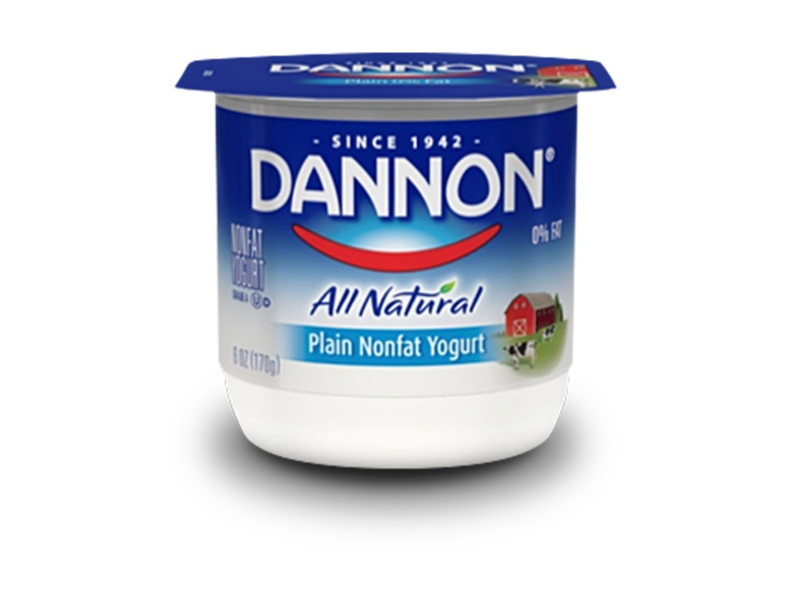



AM SNACK
– Bins Going to 10 Classrooms
How many did they prepare for?

Slide 4
130 - Snacks were prepared.
There are enough of both food groups for 13 complete snacks.

Slide 5

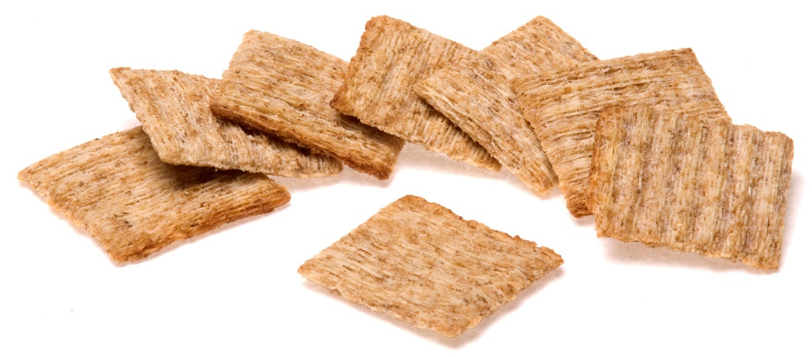



EMM
350 Students Enrolled;
16 Classes; Bins in Classes
How many did they prepare for?

Slide 6
160
10 Early Morning Meals were prepared per class.

Slide 7



PM Snack – School Feeds 450 Kids Grab & Go Style, 4 Separate Stations.
How many did they prepare for?

Slide 8

0
No fruits or vegetables were included in the snack. Fruits/Vegetables MUST be offered at EACH Student Nutrition Program.
How can we correct this?

Slide 9

Add 15 apples to each station.
Now how many did they prepare for?

Slide 10

Complete PM Snacks were prepared.

Slide 11



AM Snack
Reporting 450 students; 5 days / week
Bin Program (15 Classrooms)
Bins filled on Monday:

Slide 12


AM Snack Continued
Wednesday, replenish the bins; add:

Slide 13



AM Snack Continued
Collect Bins on Friday. LEFT in the bin are…
How many days is this program operating?

Slide 14
Actually operating 2 days a week!
How many students should they be reporting?
30 Students x 15 = 450 twice a week
New reporting is capturing ‘Meals Prepared’ per program day. In this scenario, 30 snacks were prepared on Monday and delivered. On Wednesday, the bins were topped up to bring each food group back up to 30 for each class. Left overs are counted again.

Slide 15






Sit Down EMM, Designated 5 days/week, reporting 367 currently.
42
24
100
22
Does it meet our guidelines for a meal? If not, what needs to be added?

Slide 16
Grains
Added 50 English muffins (= 100 servings)
How many students should they be reporting now?
42
Due to number of dairy products, even though there are 188 fruit/vegetable servings.

Slide 17


Snack Program
16 Bins, collected and distributed each day.
20
20
Each morning a new bin arrives with 20 servings, extras are reused throughout the week.
How many days is this program running?
How many meals should be reported each day?

Slide 18
0
This does not qualify for a Snack Program as there are no fruits/vegetables being offered. If you simply switched out either the milk or the granola bar with a fruit/vegetable such as bananas, you would have a proper Snack.
This program operates 5 days/week.
The total reported meals served/day should be 320 (20 bins x 16 classrooms)

Slide 19

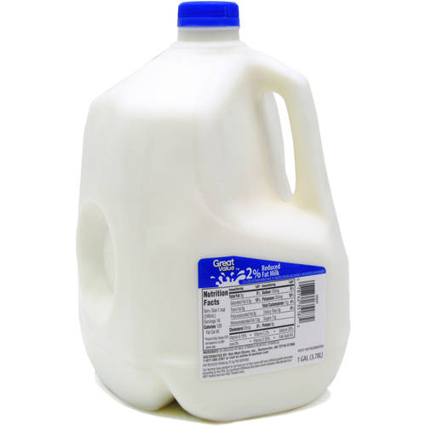
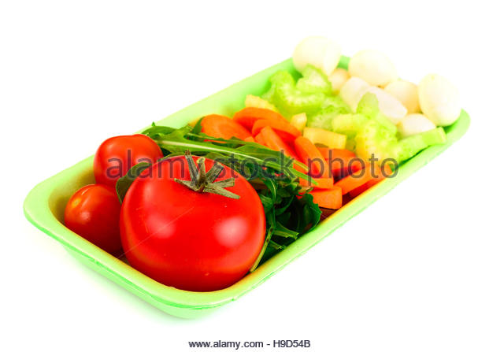
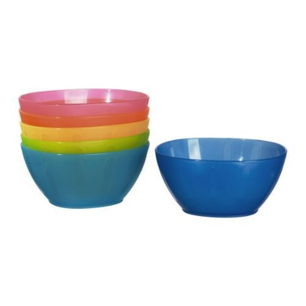

Sit Down Breakfast Program
Currently reporting 25 students
2
3 ltrs
25
Tray
25
How many kids are they serving? 1400g/30g=46 cereal servings; 3 litres milk = 13.2 cups
They are serving 13 – 14 kids

